Slide 1
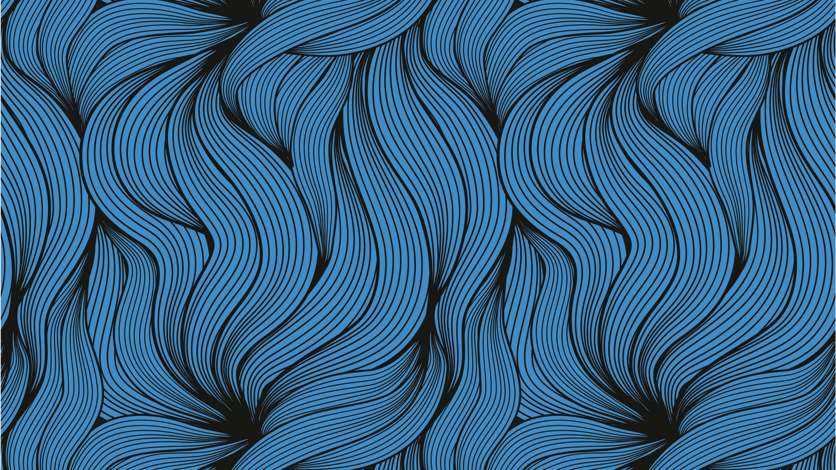
Concept art 2d
Name- Siddharth Saroha
Id- 2111981278

Slide 2
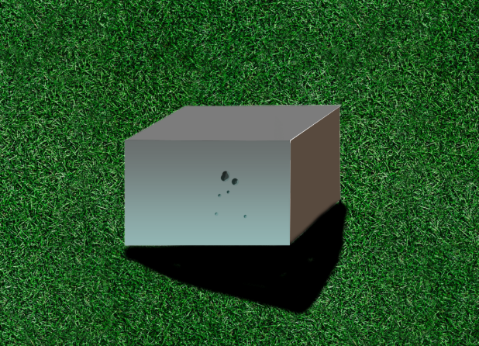
Steel Box
Making a steel texture on a cuboid
using Selection, brush and lasso tool.

Slide 3
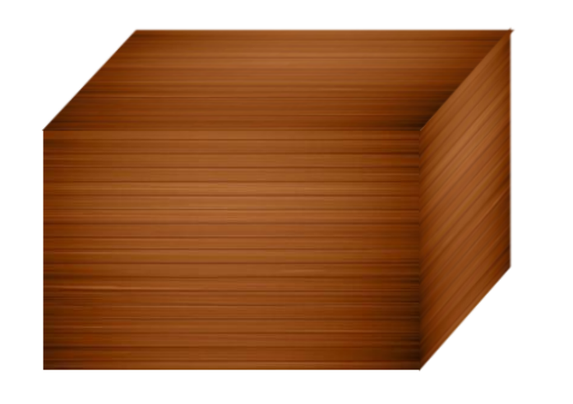
Wooden Box
Making a Wooden texture on a cuboid
using Selection, brush and lasso tool.

Slide 4
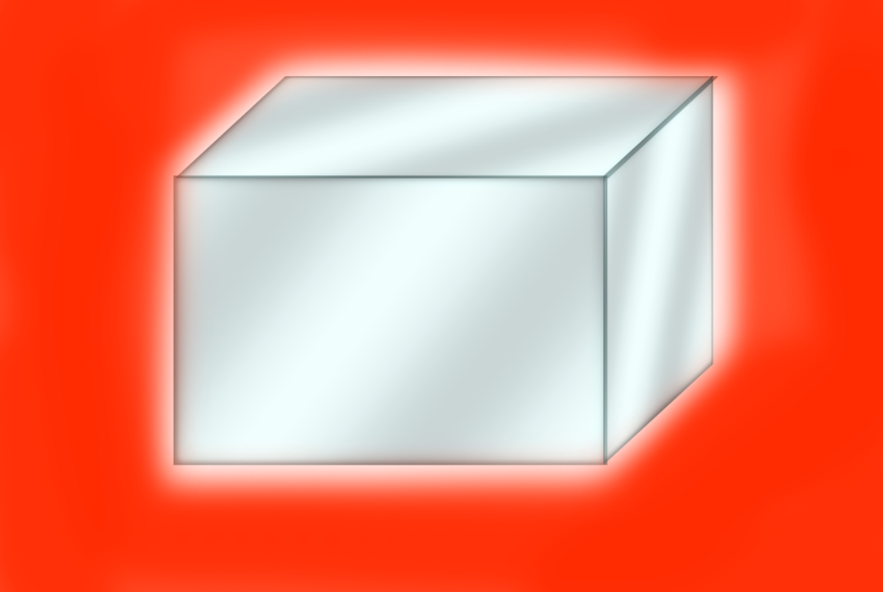
Mirror Box
Making a Mirror texture on a cuboid
using Selection, brush and lasso tool.

Slide 5
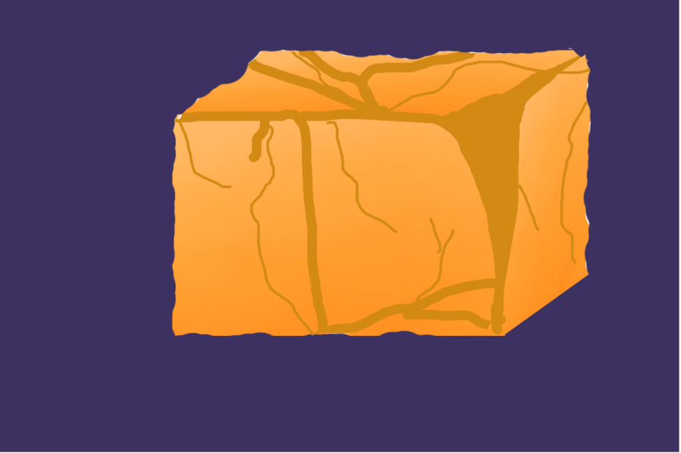
Rock Texturing
Making a steel texture on a cuboid
using Selection, brush and lasso tool.

Slide 6
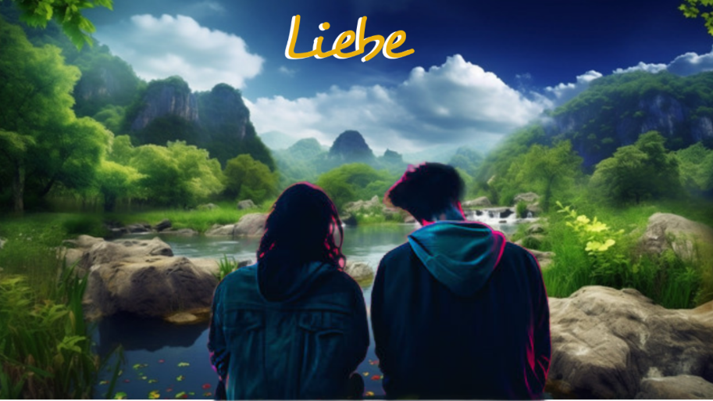
Game Poster
Making game poster by removing
Background of a image and pasting it
on another image.
Then Naming it with effects.

Slide 7
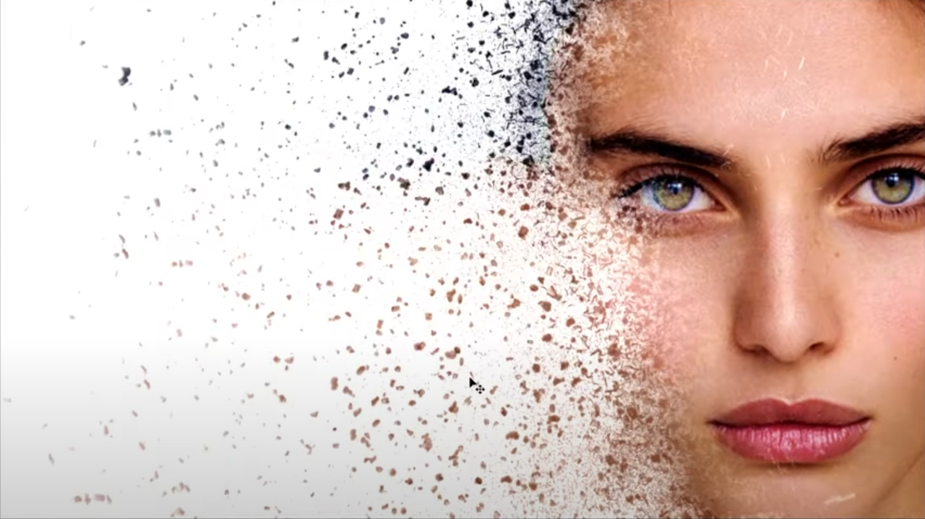
Dispersion Effects
• Firstly removing Background
Of an image.
• Then putting dispersion effects
Of white color on the face.
• stretching it in another layer.
• then again dispersion effects
On the side.

Slide 8
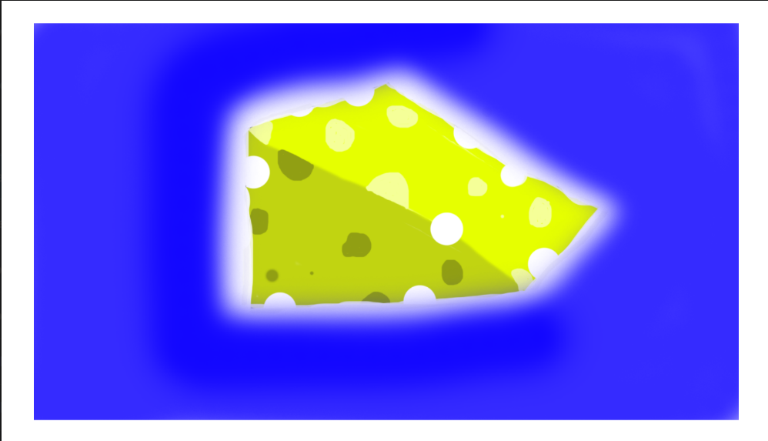
Cheese Texture
Making cheese texture using
Selection, brush and lasso
Tool with image tracing.

Slide 9
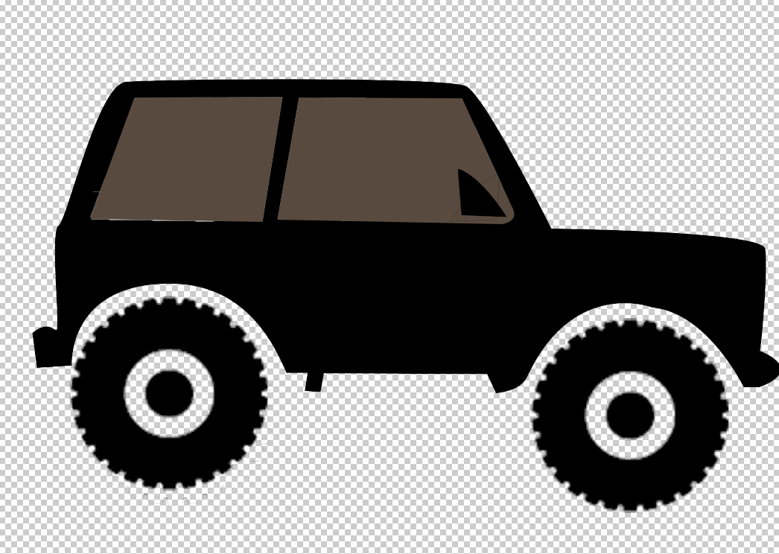
Vehicle Concept
Making car using Image tracing, Brush,
selection and Lasso tool

Slide 10

2d Environment
Making environment using
Background color,
Rectangle and brush tool.

Slide 11
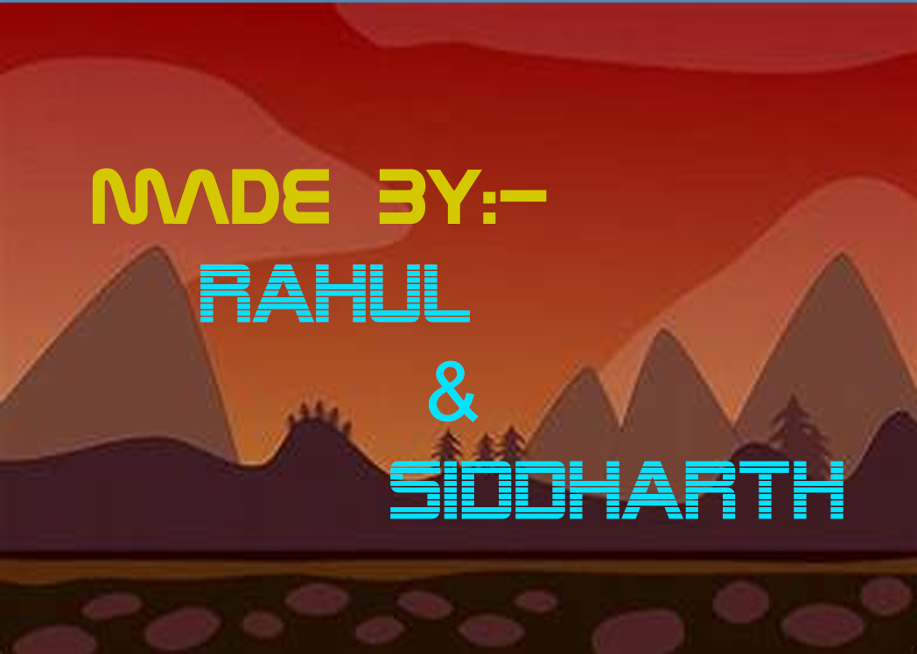
2d Game Credits
Making credits background
using Background color,
Rectangle and brush tool and
Then added the text.

Slide 12
Thank you
Special Thanks: Rajasekhara Sir

